Slide 1
Social Media Analysis on Relationship of Facebook and Instagram Post-Comments
ETC5543 Business analytics creative activity
Gui Gao 32723237
Chatpisut Makornkhan 32580231
17 October 2023

Slide 2
Contents
Introduction
Project Scope and Motivation
Challenges
Main Goals
Project Journey
Sprint and Retrospective
Fortnight Journey
Findings and Insights
R Shiny Tool
Insights
Conclusion

Slide 3
Introduction

Slide 4
Background
Internship Description
Taken place at Forethought for duration of 10 Weeks
Working under Data and Analytics team
Working as data scientists on an ad hoc project
Project Detail and Methodologies
Social media analysis on relationship of Facebook and Instagram data of post versus comments
Social media trend, sentiment and performance analysis
Text summarization and NLP with openAI large language model API

Slide 5
Objectives and Challenges
Business Objective
Understand the brands within the Social Media culture
Challenges
Unorganized raw data pulled from Social Media platform
Displaying analytical plots for multiple datasets using a single R Shiny application
Utilizing relatively new openAI package in R
Goals and Objectives
Analyze and evaluate the effectiveness of brand posts
Develop models to suggest optimal topics based on discovered themes and drivers
Understand consumers’ engagement and audience reach
Data
Pulled from Facebook and Instagram, posts and comments of Telstra, Optus, Vodafone and Amaysim
From April 2021 upto August 2023

Slide 6
Project Journey

Slide 7
Forethought’s workflow through 'Sprint' and 'Retrospective'
Sprint Plan
Retrospective
Data Wrangling and Preliminary Analysis
What was good? | What needed improvement?
Ideas | Actions
Package and Report Finalization
Project Inception and Market Analysis
Insights Analysis and Report Preparation

Slide 8
The First Sprint Plan: Project Inception and Market Analysis
Project Inception and Market Analysis
Definition of Done
Thorough understanding of project scope and objectives
Stories
Getting initiated about project scope, goals and data
Understanding the overall analysis
Establishing and framing
Data cleaning and preparing stage
Learning Outcomes
Project Set-up
Team Alignment
Data learning

Slide 9
The Second Sprint Plan: Data Wrangling and Preliminary Analysis
Data Wrangling and Preliminary Analysis
Definition of Done
Regex and Gsub functions for data cleaning
Multiple data alignment between post and comments datasets
Stories
Finalizing data cleaning process
Analysis process initializing
Exploratory Data Analysis
Objective-based analysis
Deep-dive exploratory analysis
Learning Outcomes
Structural and simultaneous data cleaning
Systematic EDA for clear and concise deep-dive analysis objectives

Slide 10
The Third Sprint Plan: Insights Analysis and Report Preparation
Insights Analysis and Report Preparation
Definition of Done
OpenAI – prompt engineering, Refining the ideas, Exploratory Analysis objectives
R Shiny application integration
Stories
Packages initializing
Wrapping-up cleaning data and analysis
Processing insights and findings - through R Shiny app and openAI analysis
Presentation preparation
Learning Outcomes
Access to openAI package in coding languages (R and Python)
Package builder
Insights incorporating in R Shiny app

Slide 11
The Fourth Sprint Plan: Project Wrap-Up
Package and Report Finalization
Definition of Done
Understanding of usage of R Shiny in organizational setting
Stories
Exploring on R Shiny and coding documentation
Completion of data cleaning and analysis
Consolidating R Shiny app and Insights
Cross-checking across prior Sprint Plan
Learning Outcomes
Efficiently produce R Shiny app through building block
Alignment of findings and insights with initial objectives and goals
Packages documentation for internal usage

Slide 12
Findings and Insights

Slide 13
Social Media Analysis Tool: R Shiny App

Slide 14
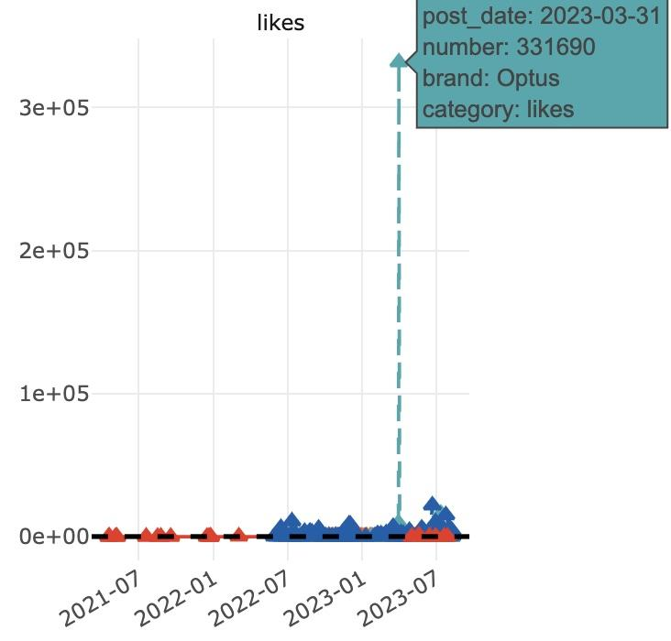
Exploratory Findings: The huge gap in likes number
The Instagram post by Optus has garnered over 330,000 likes number
Optus collaborated with Daniel Ricciardo to publish this post
Daniel is a famous Australian racing driver and has around 900,000 fans
Celebrity effect

Slide 15
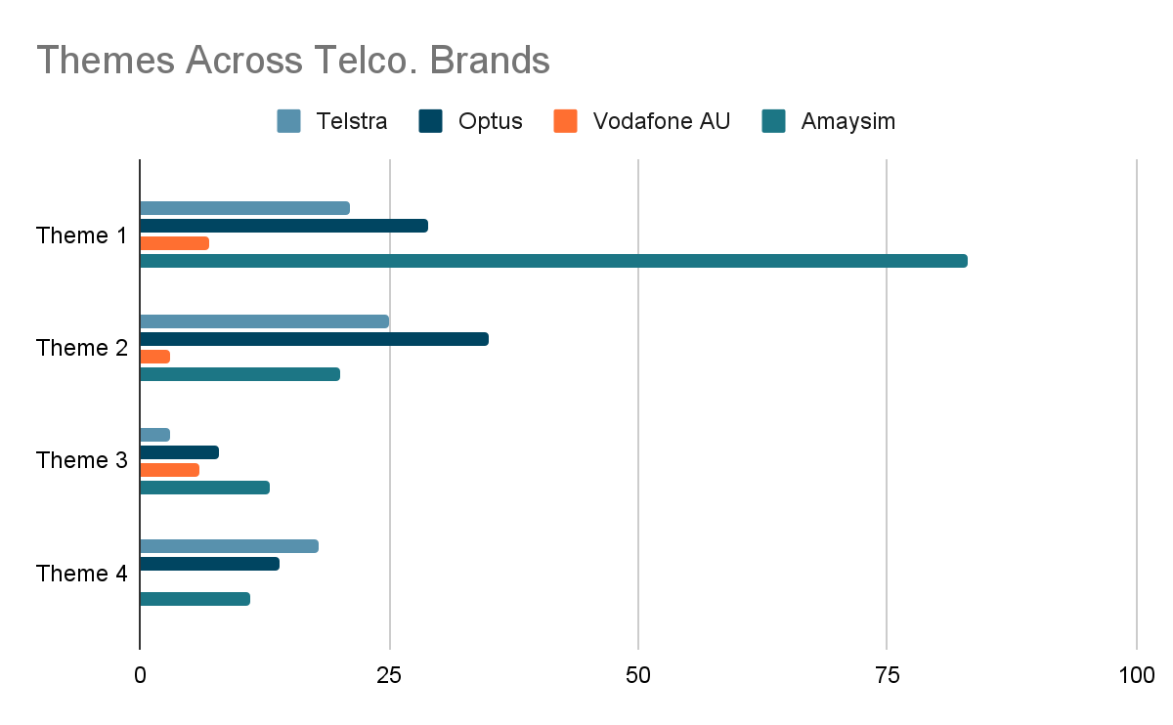
NLP Findings: Social Media Overview
Previous findings would only give observational analysis based on simple sentiment analysis
With help of NLP, incorporating appropriate prompt in openAI completion function, themes (post) and drivers (comment) can be meaningfully detected
Themes allow further analysis linkage with comments to find consumer driver later on
Understand how brand engage with consumer through themes and post style - analyze performance

Slide 16
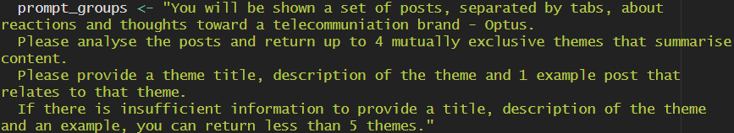
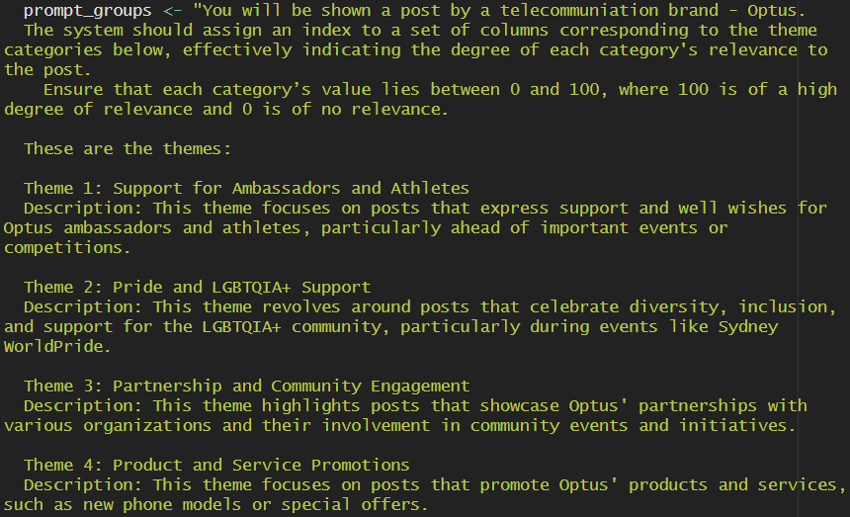
NLP Findings: Social Media Overview (Cont.)
To find Optus Instagram Post themes, create completion function in openai package is used
With following prompt
First prompt for themes detection
Second prompt for themes classification

Slide 17
NLP Findings: Social Media Overview (Cont.)
Optus Instagram Post Themes
Theme 1: Support for Ambassadors and Athletes
Description: This theme focuses on posts that express support and well wishes for Optus ambassadors and athletes, particularly ahead of important events or competitions.
Theme 2: Pride and LGBTQIA+ Support
Description: This theme revolves around posts that celebrate diversity, inclusion, and support for the LGBTQIA+ community, particularly during events like Sydney WorldPride.
Theme 3: Partnership and Community Engagement
Description: This theme highlights posts that showcase Optus' partnerships with various organizations and their involvement in community events and initiatives.
Theme 4: Product and Service Promotions
Description: This theme focuses on posts that promote Optus' products and services, such as new phone models or special offers.
Note: Each brand has its own different description and number of themes
Help identify highly engaged post - its theme
Understanding relationship of engagement through like and share number of well-perform posts
Gain better understanding and insights from consumer through their comments via drivers

Slide 18
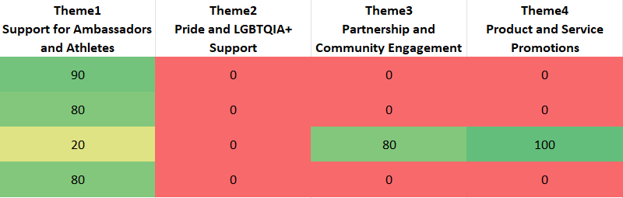
NLP Findings: Social Media Overview (Cont.)

Slide 19
NLP Findings: Social Media Post
Post Caption: Not sure I'm a great sales rep. Appreciate @optus & @fitzywippakate for letting me try
For example, previously mentioned Instagram post by Optus
We can identify its performance comparatively among itselves
See which brand perform well under particular themes
Theme 1: Support for Ambassadors and Athletes
Theme 1 Performance Support for Ambassadors and Athletes
Theme 2 Performance Pride and LGBTQIA+ Support
Theme 3 Performance Partnership and Community Engagement
Theme 4 Performance Product and Service Promotions
Number of Post | 26
Average number of Like | 112.3
Average number of Comments | 3.4
Number of Post | 9
Average number of Like | 73.6
Average number of Comments | 0.8
Number of Post | 17
Average number of Like | 98.4
Average number of Comments | 1.8
Number of Post | 14
Average number of Like | 76.7
Average number of Comments | 1.3

Slide 20
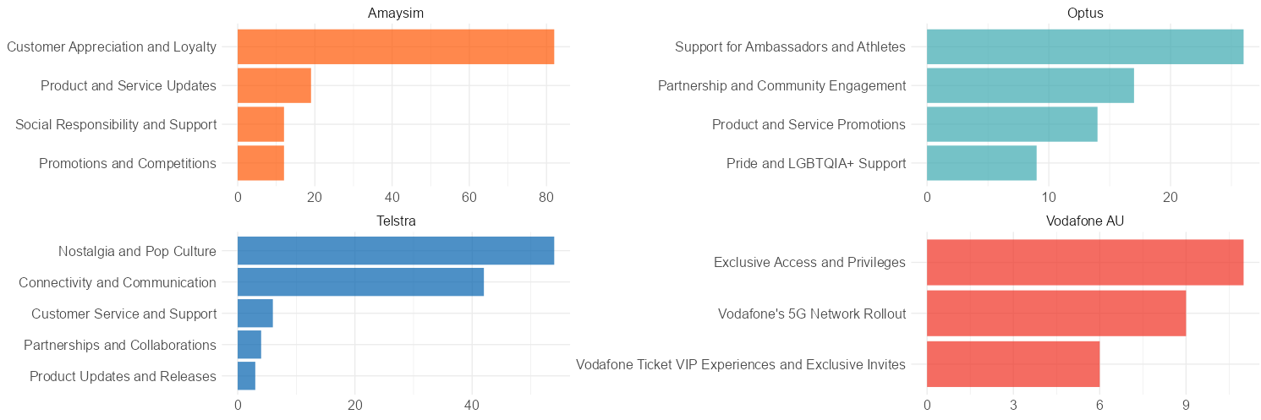
NLP Findings: Social Media Post (Cont.)

Slide 21
NLP Findings: Social Media Post (Cont.)
For example, previously mentioned Instagram post by Optus
We can identify its performance comparatively among itselves
Post Caption: Not sure I'm a great sales rep. Appreciate @optus & @fitzywippakate for letting me try
Theme 1: Support for Ambassadors and Athletes
We can see how well this collaboration post perform
Also, we can analyze its performance against other post within the same theme
Theme 1 Performance
Daniel’s Collab Post Performance
Number of Post | 26
Average number of Like | 112.3
Average number of Comments | 3.4
Number of Like | 331690
Number of Comments | 39

Slide 22
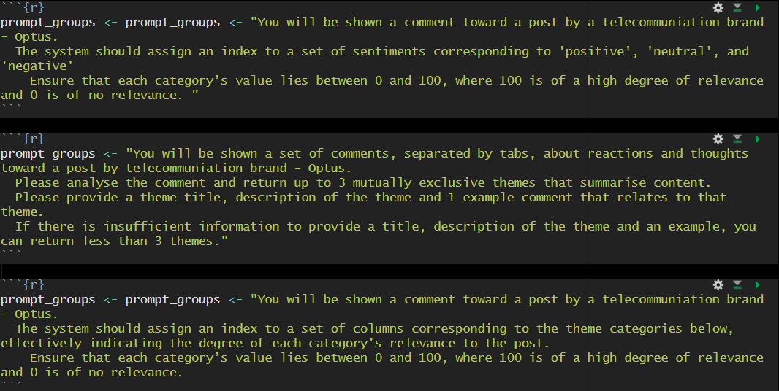
NLP Findings: Social Media Comment
Same can be done with comments
Adding extra prompt on each comment overall sentiment

Slide 23
NLP Findings: Social Media Comment (Cont)
Daniel’s Collab Post Performance
Number of Like | 331690
Number of Comments | 39
Giving insights toward particular post
Checking post and brand health
Fine tune post for brand to obtain preferred drivers from consumer
Overall Sentiment
Comment Drivers
Positive | 25
Neutral | 12
Negative | 2
Ricciardo’s Supportive Fans | 29
Amusing and Entertaining | 10

Slide 24
Conclusion

Slide 25
Next steps…
To analyze deeper into whether different posts sentiment affect user comments
To understand consumer drivers and reaction towards post themes
To discuss with client on ROI for high value post investment
To identify next steps and recommendations for brand following their post patterns and enhance their themes and engagement performance

Slide 26
Thank You

Slide 27
Acknowledgement
R Packages
ggplot2
DT
ggplot2
ggraph
igraph
lubridate
mice
openai
openxlsx
plotly
readxl
reshape2
rintrojs
shiny
shinyBS
shinydashboard
shinyjs
shinyWidgets
stopwords
stringr
tidygrap
tidytext
webr
wordcloud
wordcloud2

Slide 28
Q&A

